Slide 1
Unit ‘6’ Network Security & Public Key Infrastructure
Prepared by: Abhishek Dewan Lecturer, Cryptography

Slide 2
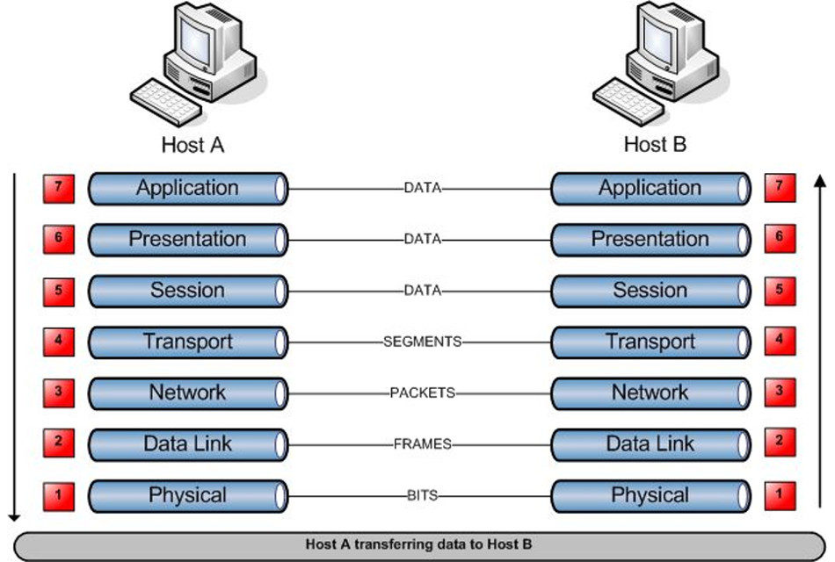
ISO/OSI model

Slide 3
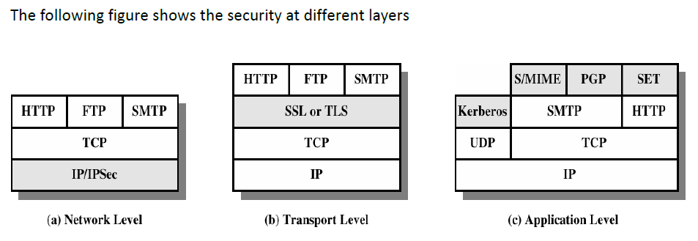
Security at different layers

Slide 4
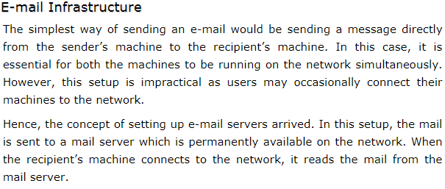
Security at the Application Layer: Email

Slide 5
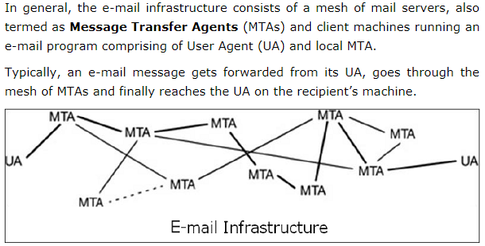

Slide 6
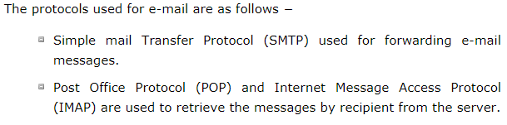
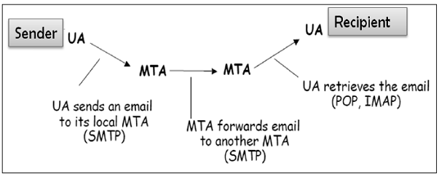

Slide 7
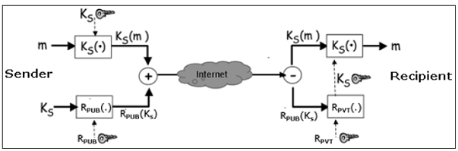
Let’s assume a sender wants to send a confidential e-mail to a recipient. The provision of privacy in this case is achieved as follows −

Slide 8
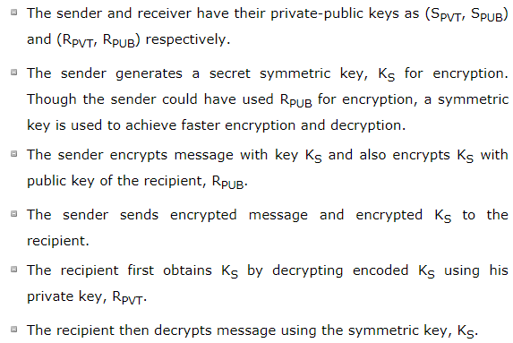

Slide 9
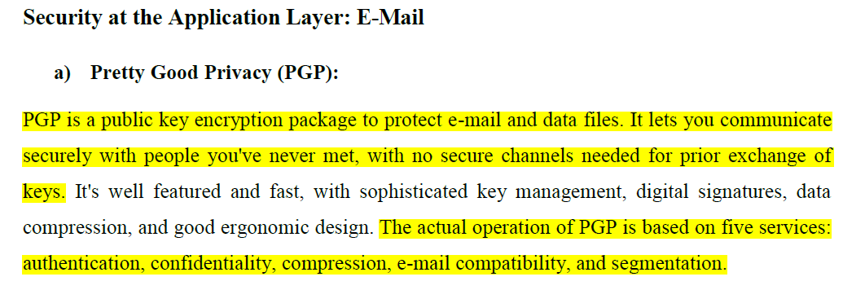
Security at Application Layer

Slide 10
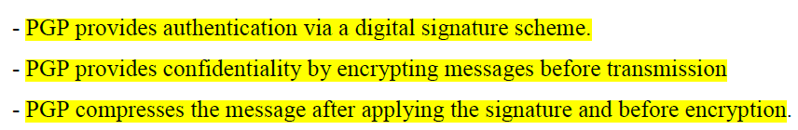

Slide 11
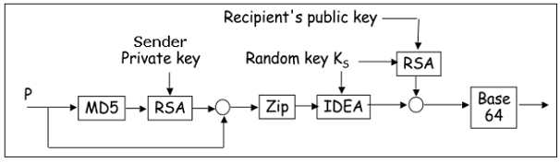
Working of PGP

Slide 12
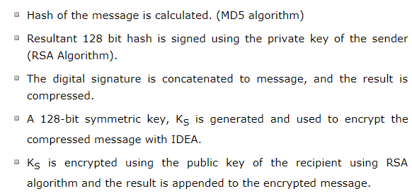

Slide 13
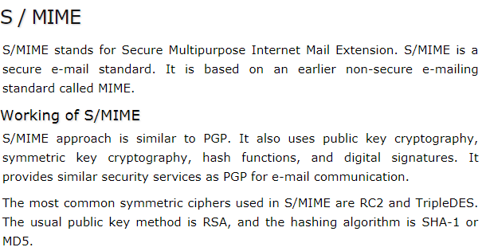

Slide 14
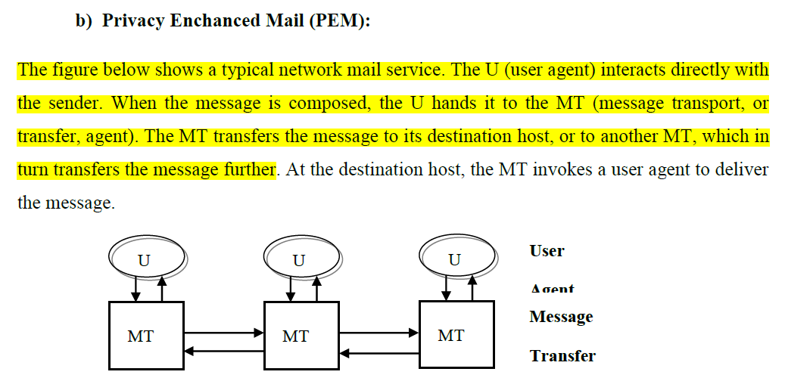

Slide 15
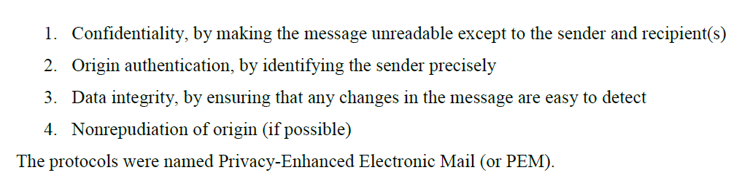
Internet Engineering Task Force(IETF) with the goal of email privacy develop electronic mail protocols that would provide the following services:

Slide 16
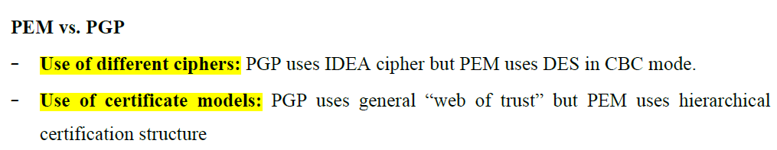

Slide 17
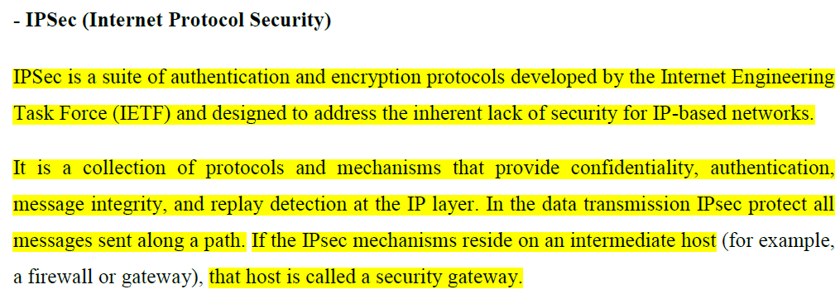
Security at Network Layer

Slide 18
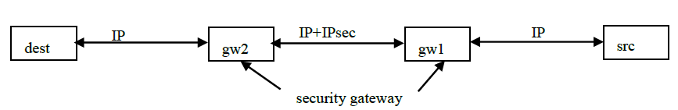

Slide 19
Security at Transport Layer
Secured Socket Layer(SSL)
The secure Socket Layer is a standard developed by Netscape Corporation to provide security in WWW browsers and servers.

Slide 20
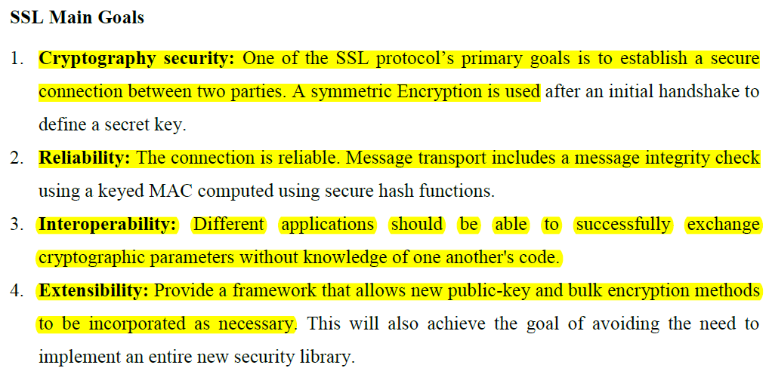

Slide 21
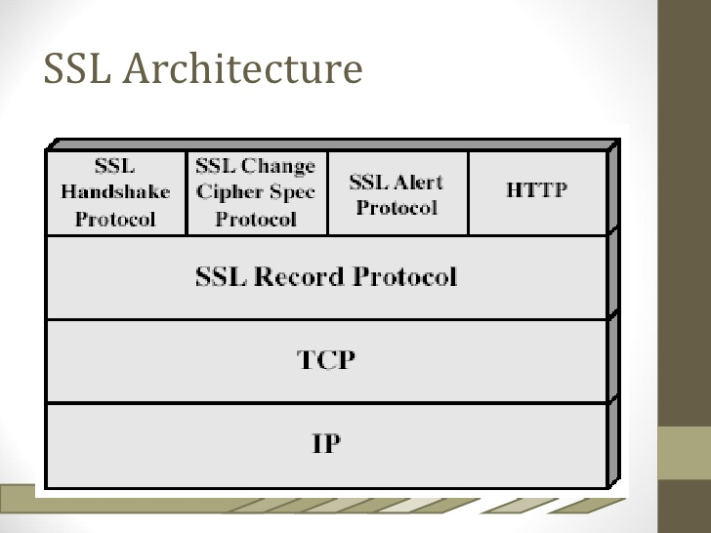
SSL Architecture

Slide 22
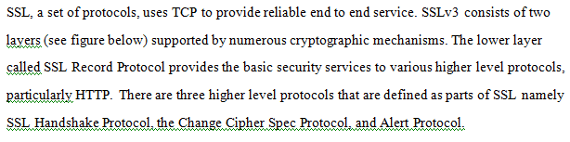

Slide 23
SSL works in terms of connections and sessions between clients and servers.
An SSL session is an association between two peers.
An SSL connection is the set of mechanisms used to transport data in an SSL session.
A single session may have many connections.
Each party keeps information related to a session with each peer.

Slide 24
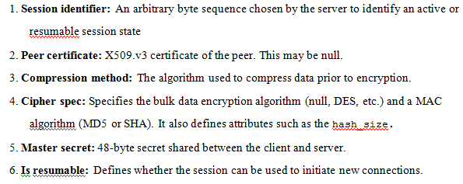
The data associated with a session includes the following information:

Slide 25
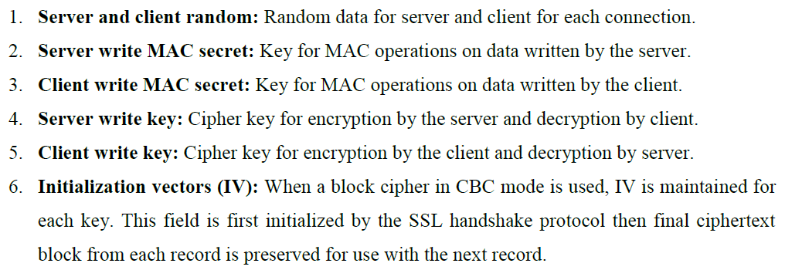
The information associated with the connection includes the following:

Slide 26
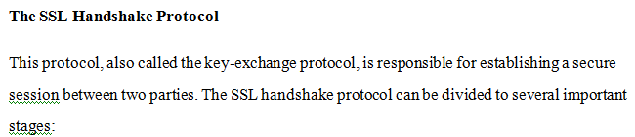
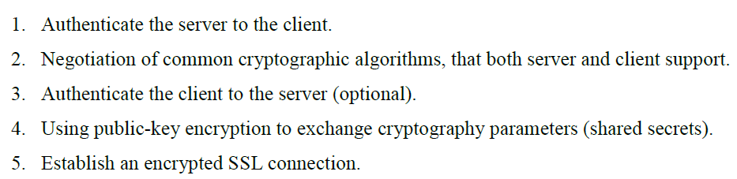

Slide 27
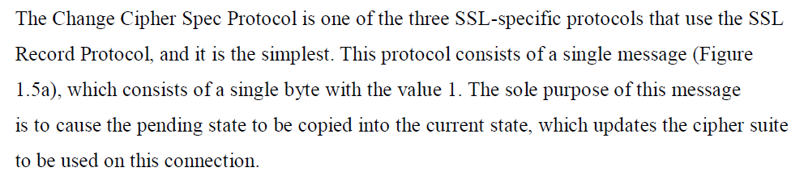
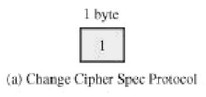
Change Cipher Spec Protocol

Slide 28
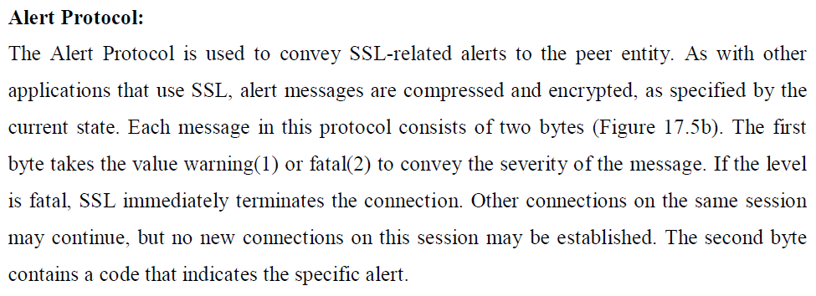
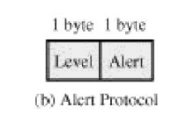

Slide 29
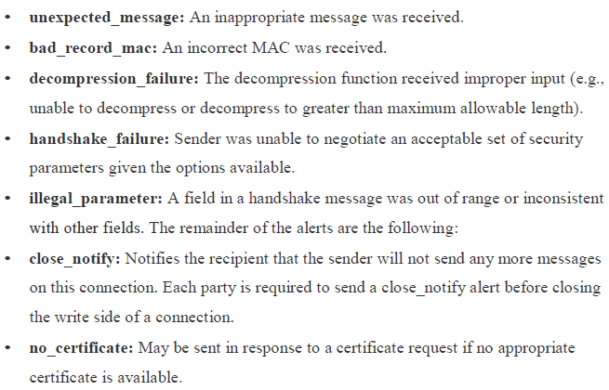

Slide 30
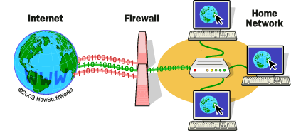
Firewall

Slide 31
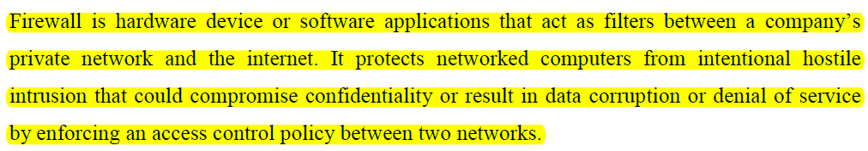

Slide 32
The main purpose of a firewall system is to control access to or from a protected network (i.e., a site).
It implements a network access policy by forcing connections to pass through the firewall, where they can be examined and evaluated.
A firewall system can be a router, a personal computer, a host, or a collection of hosts, set up specifically to shield a site or subnet from protocols and services that can be abused from hosts outside the subnet.

Slide 33
A firewall system is usually located at a higher level gateway, such as a site's connection to the Internet, however firewall systems can be located at lower-level gateways to provide protection for some smaller collection of hosts or subnets.

Slide 34
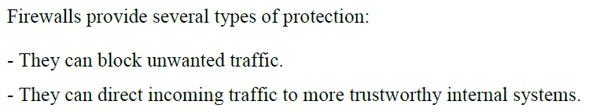
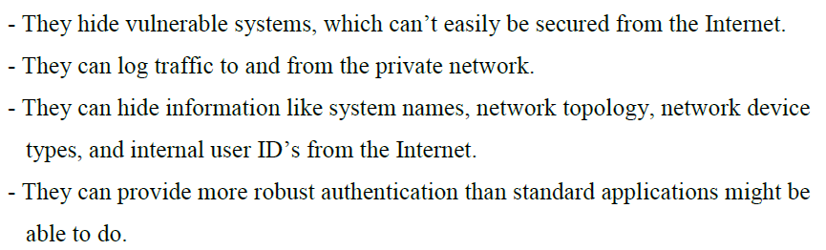

Slide 35
Cover Types of Firewall Yourself

Slide 36
Public Key Infrastructure (PKI) Trust Model
In large networks with varying communication topologies where network communicating elements cannot belong to the same key distribution center(KDC) becomes a real problem.
Its solved when PKI is used instead of KDC.

Slide 37
A public key infrastructure (PKI) is a set of roles, policies, hardware, software and procedures needed to create, manage, distribute, use, store and revoke digital certificates and manage public-key encryption.

Slide 38
a PKI is an arrangement that binds public keys with respective identities of entities (like people and organizations).
The binding is established through a process of registration and issuance of certificates at and by a certificate authority (CA).
Depending on the assurance level of the binding, this may be carried out by an automated process or under human supervision.

Slide 39
The PKI role that assures valid and correct registration is called a registration authority (RA).
An RA is responsible for accepting requests for digital certificates and authenticating the entity making the request.

Slide 40
An entity must be uniquely identifiable within each CA domain on the basis of information about that entity.
A third-party validation authority (VA) can provide this entity information on behalf of the CA.

Slide 41
A PKI consists of:
Certificates
A certificate authority (CA) that stores, issues and signs the digital certificates;
A registration authority (RA) which verifies the identity of entities requesting their digital certificates to be stored at the CA;
A central directory—i.e., a secure location in which keys are stored and indexed;
A certificate management system managing things like the access to stored certificates or the delivery of the certificates to be issued;
A certificate policy which states the PKI's requirements concerning its procedures. Its purpose is to allow outsiders to analyze the PKI's trustworthiness.

Slide 42
Life Cycle of Certificate
PKI identifies a number of management functions that potentially need to be supported by management protocols. :
Registration:
This is the process whereby a user first makes itself known to a CA (directly or through an RA), prior to that CA issuing a certificate or certificates for that user.
Registration begins the process of enrolling in a PKI.
Registration usually involves some offline or online procedure for mutual authentication. Typically, the end entity is issued one or more shared secret keys used for subsequent authentication.

Slide 43
Initialization:
Before a client system can operate securely, it is necessary to install key materials that have the appropriate relationship with key stored elsewhere in the infrastructure.
For example, the client needs to be securely initialized with the public key and other assured information of the trusted CA(s), to be used in validating certificate paths.

Slide 44
Certification:
This is the process in which a CA issues a certificate for a user’s public key, returns that certificate to the user’s client system, and/or posts that certificate in a repository.

Slide 45
Key pair recovery:
Key pairs can be used to support digital signature creation and verification, encryption and decryption, or both.
When a key pair is used for encryption/decryption, it is important to provide a mechanism to recover the necessary decryption keys when normal access to the keying material is no longer possible, otherwise it will not be possible to recover the encrypted data.
Loss of access to the decryption key can result from forgotten passwords/PINs, corrupted disk drives, damage to hardware tokens, and so on. Key pair recovery allows end entities to restore their encryption/decryption key pair from an authorized key backup facility (typically, the CA that issued the end entity’s certificate).

Slide 46
Key pair update:
All key pairs need to be updated regularly (i.e., replaced with a new key pair) and new certificates issued.
Update is required when the certificate lifetime expires and as a result of certificate revocation.

Slide 47
Revocation request (Cancelling request):
An authorized person advises a CA of an abnormal situation requiring certificate revocation.
Reasons for revocation include private- key compromise, change in affiliation, and name change.

Slide 48
End of Unit ‘6’

